Slide 1
ALL INFORMATION
SUBMITTED WITHOUT PREJUDICE
“Not My Job…”
NOT EVEN FOR THE RCMP, THE ONTARIO PROVINCIAL POLICE OR MUNICIPAL POLICE…
IN MATTERS OF BREACH OF PUBLIC TRUST
BY ELECTED OFFICIALS AND ENFORCEMENT BODIES…
“Not My Job…”
A phrase that – in matters of public safety - was unacceptable!

Slide 2
SUBMITTED WITHOUT PREJUDICE…
ALL INFORMATION IN THIS FILE AS WELL AS IN ANY AND ALL DOCUMENTS PERTAINING TO THIS MATTER WHICH ARE ASSOCIATED WITH THESE ISSUES AND/OR OUR INVESTIGATION OF THESE ISSUES ARE
SUBMITTED WITHOUT PREJUDICE

Slide 3
This presentation has been compiled to document relevant facts, and/or convey events and/or opinions as we experienced them and/or developed them over time as a result of everything we have been put through by various GOVERNMENT AND ENFORCEMENT parties as we came to uncover what was in our opinion the breaking of laws by many.
Until proven in a court of law, all materials and references in this document pertaining to “violations” are to be considered “alleged” violations as these individuals have yet to be proven/found guilty in a court of law. The intent of this document is to bring to light matters of accountability that, in our opinion, must be addressed.
This document is protected by COPYRIGHT and PRIVACY laws.
No person has the right to reproduce and/or distribute this document– in part or in full – in any way (i.e., in print, electronically, or otherwise) without the prior WRITTEN authorization of Jeanne A. Robitaille-Brohart
Note: All emphasis as it relates to text style, underlining, arrows, special boxes, etc. were added by the author of this presentation.
2009 - Present

Slide 4
2 MASSIVE SCANDALS… THE POLICE HAS REFUSED TO INVESTIGATE:
Employment Insurance Fraud at the Canada Revenue Agency (CRA)
A nation-wide building scandal in truss design colliding on many fronts with the
“Elliot Lake mall collapse scandal”
WHY NO INVESTIGATION?
If there has been no investigation and/or public disclosure of the issues by the press it is in my opinion because “the players” involve KEY POLITICIANS and KEY ENFORCEMENT BODIES that were supposed to be there to protect the public in the first place.
These scandals were referred to top echelon… and still… nothing appears to have been investigated and/or made public in these critical issues.

Slide 5
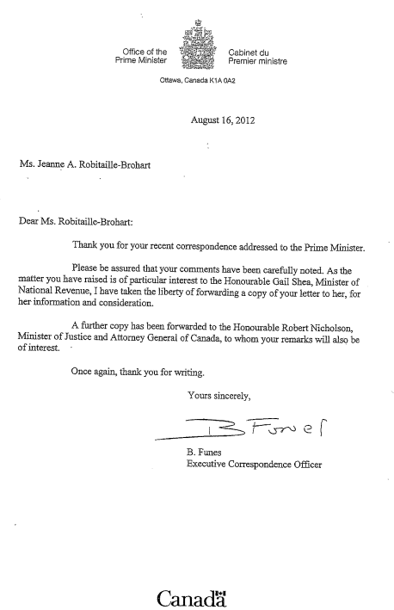
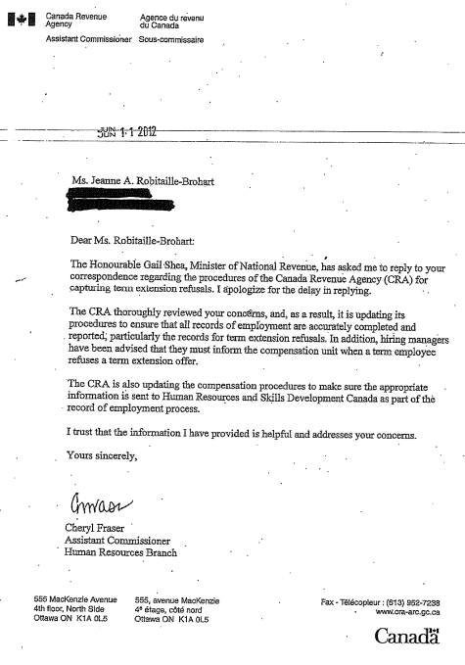
Canada Revenue Agency Employment Insurance Fraud Scandal…
WHO KNEW… Those below… plus emails to almost all federal legislators...
Why were appropriate methods/procedures not already there to prevent such fraud tactics at the CRA?

Slide 6
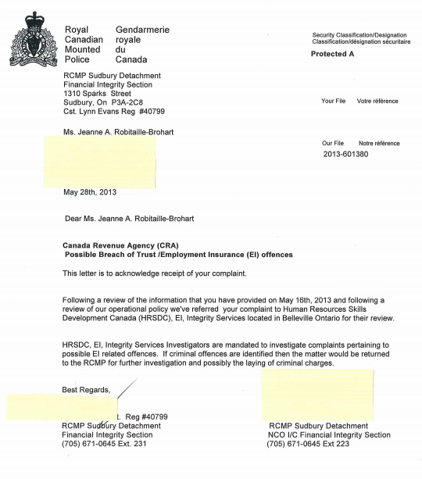
Canada Revenue Agency Employment Insurance Fraud Scandal…
POTENTIAL FRAUD AT A FEDERAL AGENCY FALLS
UNDER THE RCMP… BELOW IS “THEIR RESPONSE”…
“IT ISN’T OUR JOB UNTIL WE ARE TOLD IT IS OUR JOB!!!
WAS IT NOT THE JOB OF HRSDC
(Diane Finley’s Office) TO MAKE SURE APPROPRIATE METHODS AND PROCEDURES WERE IN PLACE TO PREVENT SUCH FRAUD TACTICS AT THE CRA IN THE FIRST PLACE? (I suspect if methods and procedures were not in place at the CRA, they were probably not in place in any federal agency!)
Documentation For CRA EI Scandal is posted at:
http://www.CRA-EI-Scandal.com
SO… THE VERY PERSON/OFFICE THAT NEEDS TO BE INVESTIGATED NOW HEADS ITS OWN FRAUD/BREACH OF PUBLIC TRUST INVESTIGATION INSTEAD OF THE RCMP???
AN ISOLATED INCIDENT – OR TREND IN WRONGDOING INVESTIGATIONS/BREACH OF PUBLIC TRUST BY PUBLIC SERVANTS?
THE DISTURBING ANSWER APPEARS TO BE… “TREND”… READ ON…

Slide 7
Scandal 2 – A Nation-Wide Building Scandal…
Involves FIRST NATIONS - that makes it FEDERAL since First Nations Do NOT Fall Under Any Provincial Building Code…
Also FEDERAL because it involves truss design software by Alpine Systems (division of IL Tool Works) (used in my case) found in over 550+ truss manufacturing facilities in North America, as well as software from MiTek (parent company is Berkshire Hathaway – Warren Buffet’s company) which was used by the same truss sales rep for years while at another truss company…
Epicenter of this scandal… once again, like the CRA Scandal…
City of Greater Sudbury, Ontario, Canada!

Slide 8
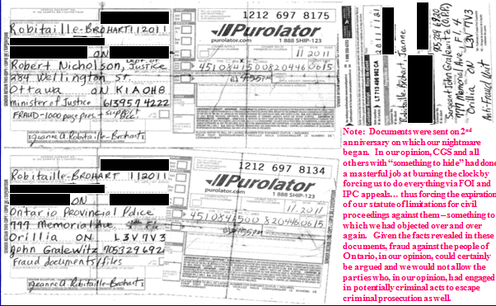
WHO KNEW… AND WHEN???
In addition to those below… I sent emails on this scandal to the entire legislature (except MPPs Bartolucci (Chair Of McGuinty Cabinet) and Gerretsen (Attorney General)) of Ontario providing the reasons for which I felt BOTH these MPPs needed to “step down”…
THOUSANDS OF PAGES WERE SENT VIA TRACKABLE MAIL TO MINISTER OF JUSTICE NICHOLSON AND ONTARIO PROVINCIAL POLICE ON NOV. 20, 2011!

Slide 9
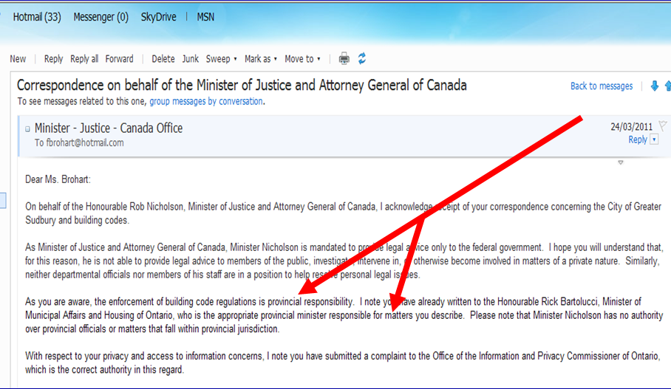
WHO KNEW… AND WHEN???
MINISTER OF JUSTICE NICHOLSON HAD RECEIVED NUMEROUS EMAILS AND HIS OFFICE REPLIED IN MARCH 24, 2011!!!

Slide 10
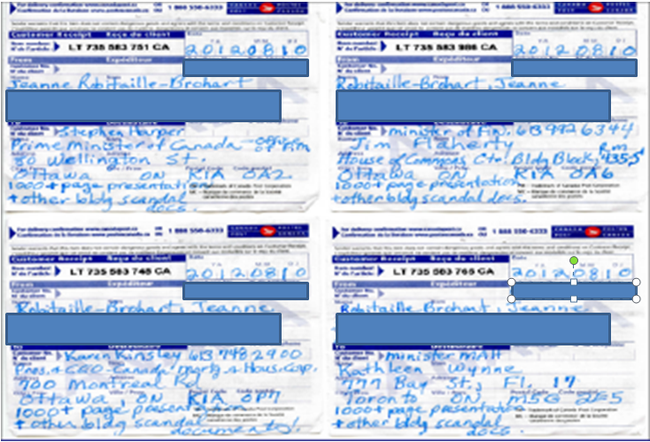
WHO KNEW… AND WHEN???
PRIME MINISTER HARPER, MINISTER OF FINANCE FLAHERTY, CANADA MORTGAGE AND HOUSING CEO KINSLEY AND FORMER MMAH WYNNE (NOW PREMIER OF ONTARIO) WERE ALL SENT “1000+ PAGE PRESENTATION & OTHER BLDG SCANDAL DOCS” AS INDICATED ON POSTAL INFO SLIPS BELOW… ON AUGUST 10, 2012!

Slide 11
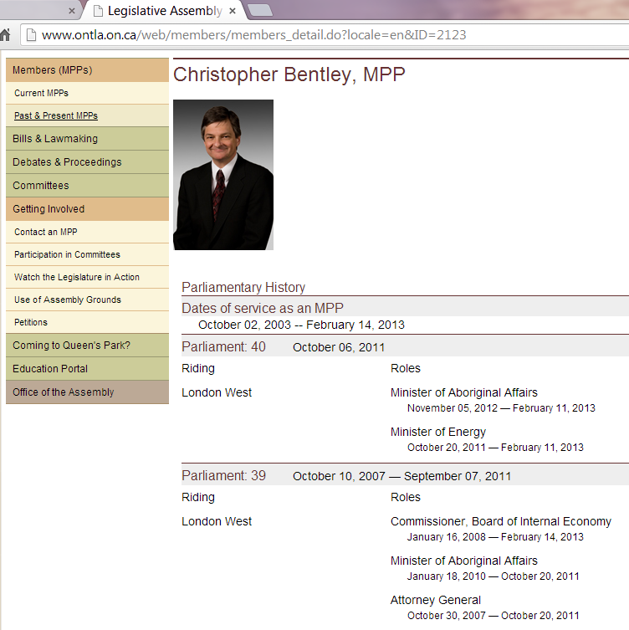
WHO KNEW AND WHEN???
WHEN MY NIGHTMARE STARTED…
THE ATTORNEY GENERAL OF ONTARIO WAS CHRIS BENTLEY…
HE WAS ALSO IN CHARGE OF ABORIGINAL AFFAIRS AS OF JAN. 2010 (REMEMBER… THIS SCANDAL INVOLVES FIRST NATIONS ALSO!!!)
I had placed a call to Ministry of Aboriginal Affairs… I have to find that phone bill (I have copies of all my phone bills) to get the actual date… but… again… my issues fell on “deaf ears” there too… maybe…
Source: Legislative Assembly of Ontario, http://www.ontla.on.ca/web/members/members_detail.do?locale=en&ID=2123

Slide 12
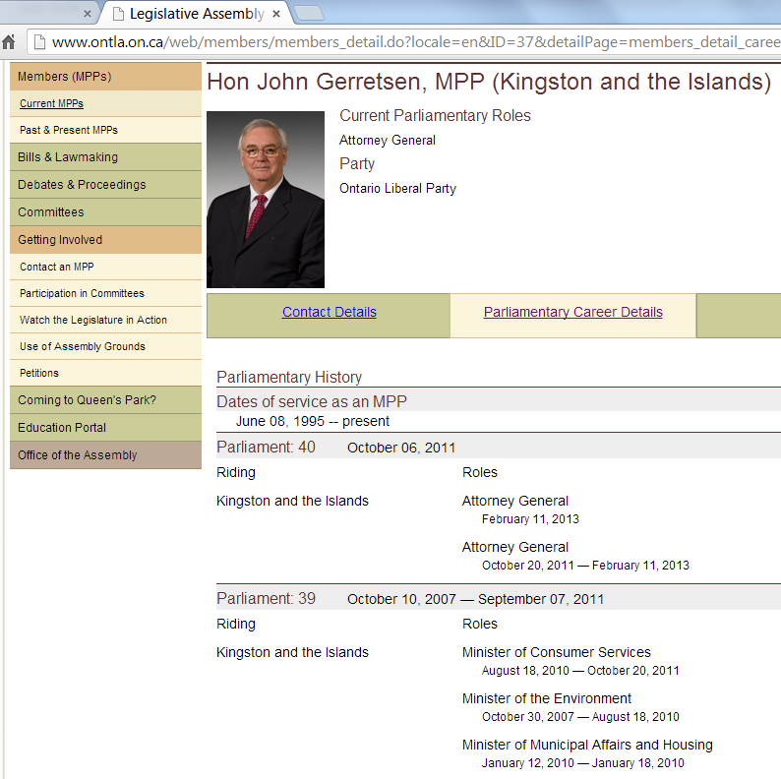
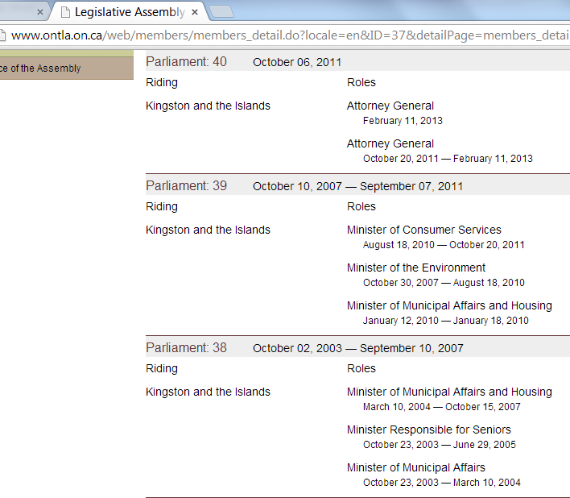
WHO KNEW AND WHEN???
WHEN ATTORNEY GENERAL BENTLEY MOVED ON…
THE NEW ATTORNEY GENERAL FOR ONTARIO WAS JOHN GERRETSEN…
WHO HAD ALSO BEEN MINISTER OF MUNICIPAL AFFAIRS IN 2007…
Source: Legislative Assembly of Ontario, http://www.ontla.on.ca/web/members/members_detail.do?locale=en&ID=37&detailPage=members_detail_career

Slide 13
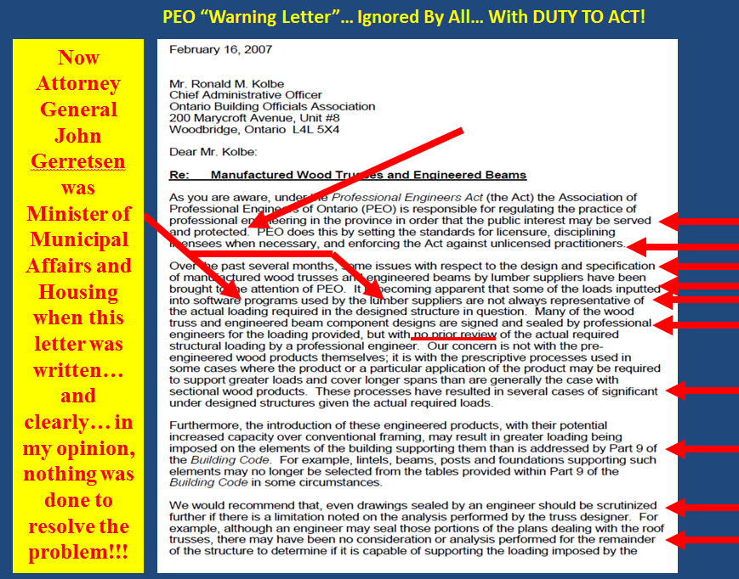
WHO KNEW AND WHEN???
THE NEW ATTORNEY GENERAL FOR ONTARIO WAS JOHN GERRETSEN…
WHO HAD ALSO BEEN MINISTER OF MUNICIPAL AFFAIRS IN 2007…
WHY WAS THAT SIGNIFICANT???

Slide 14
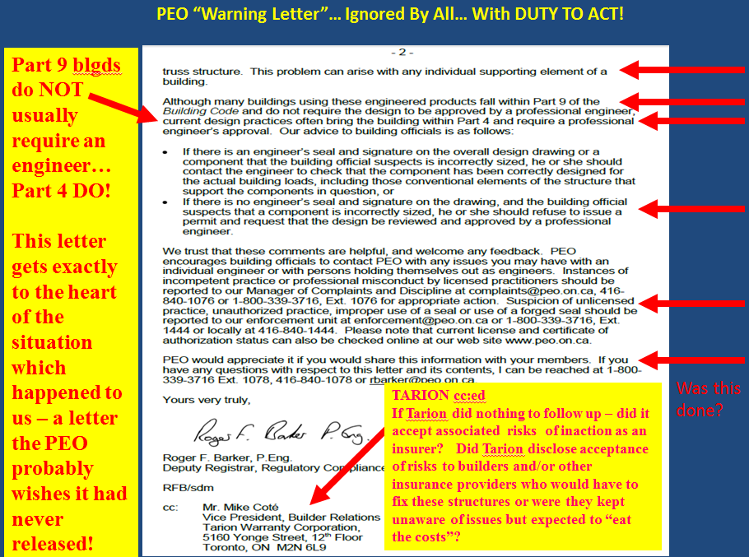
WHO KNEW AND WHEN???
THE NEW ATTORNEY GENERAL FOR ONTARIO WAS JOHN GERRETSEN…
WHO HAD ALSO BEEN MINISTER OF MUNICIPAL AFFAIRS IN 2007…
WHY WAS THAT SIGNIFICANT???

Slide 15
AS ATTORNEY GENERAL FOR ONTARIO, JOHN GERRETSEN…
WHO HAD ALSO BEEN MINISTER OF MUNICIPAL AFFAIRS IN 2007…
NOW OVERSAW ALL TRIBUNALS IN ONTARIO… INCLUDING THE IPC… WHICH WOULD VIRTUALLY ELIMINATE MY RIGHT TO ACCESS INFORMATION… LIMITING ME TO ONE FREEDOM OF INFORMATION REQUEST PER YEAR…
A MAN WHOM IN MY OPINION WAS AT THE VERY CENTER OF A NATIONAL BUILDING SCANDAL…
… WAS NOW OVERSEEING WHAT INFORMATION WOULD BE RELEASED…
… THEREBY VIRTUALLY “OVERSEEING THE INVESTIGATION” INTO THIS BUILDING SCANDAL… AND THAT OF ELLIOT LAKE…
… AND HE ALSO OVERSAW “ALL COURTS”…
AND IN MY OPINION… THAT INCLUDED WHAT I COULD ONLY DESCRIBE AS “MY KANGAROO COURT TRIAL”
BREACH OF PUBLIC TRUST???

Slide 16
THE DISTURBING TREND CONTINUES…
The Office of Diane Finley overseeing its an investigation of potential breach of public trust and/or employment insurance fraud at the CRA (and I suspected at other federal agencies) resulting from failures by this very office!!!
The Attorney General of Ontario, John Gerretsen, overseeing access to information
and the courts in matters pertaining to a nation-wide building scandal in which he
was, in my opinion, himself, a key player in matters of breach of public trust. This
same man was also the person behind the “Elliot Lake Inquiry” (costing taxpayers
millions) to “investigate problems” in “the system”… problems, in my opinion, that
were still very, very much hidden from the public because they involved the very
enforcement agencies supposedly there to protect the public in the first place!
Finally, it was - in retrospect - not surprising to see that not only at the federal and
provincial levels were key players in what was - in my opinion breach of public trust
by public servants - key players in the investigation of scandals in which they were
involved, but that this was also very much the case at the municipal level , too!

Slide 17
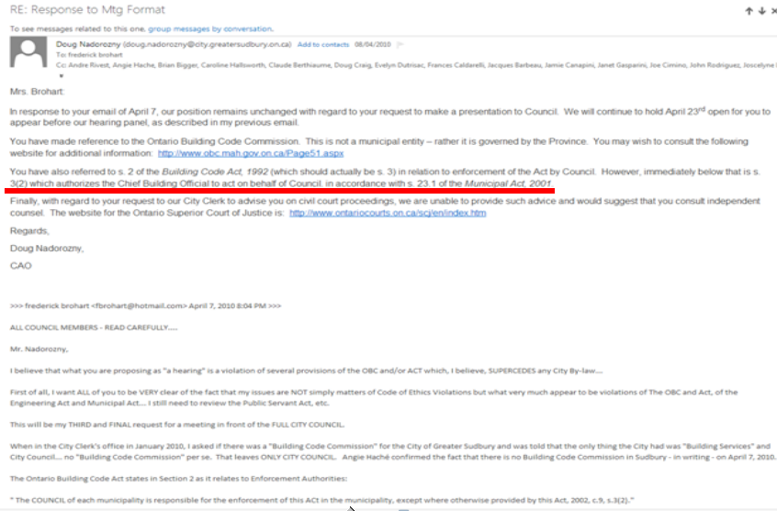
THE DISTURBING TREND CONTINUES…THE CHIEF ADMINISTRATOR FOR THE CITY OF GREATER SUDBURY SAYS HE COUNCIL CAN PUT THE CHIEF BUILDING OFFICER IN CHARGE OF THE INVESTIGATION INTO A MASSIVE BUILDING SCANDAL WITH ITS EPICENTER AS THIS MUNICIPALITY!!!
A man whose office had made the life of my family a living nightmare for 4years and counting now… a man at the very center of this now national building scandal… a scandal which constituted no less than 150 offenses at the municipal, provincial and/or federal level as submitted by myself to the Minister of Justice of Canada and the Ontario Provincial Police, the CAO would put “in charge of the investigation”!
OUTRAGEOUS BREACH OF PUBLIC TRUST!
In my opinion, this was nothing short of !!!intimidation by all on this distribution list – which included the entire city council, lawyer for the city, etc. !

Slide 18
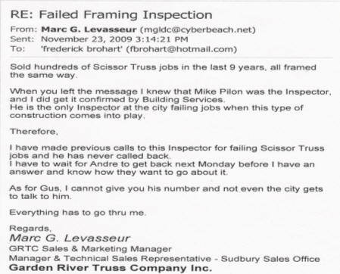
1 truss sales rep alone… in 1 municipality… did HUNDREDS of homes with
Major Structural Defects… over a 9 year period… using software found in 550+ truss manufacturing facilities in North America!!! I had tested another software package… same issues were there..
Clearly a NATIONAL INDUSTRY-WIDE PROBLEM!
How can this go on – so long – virtually UNCHECKED!
History of a problem – but – not stopped!
A non-engineer - CGS “Deputy Chief Buiding Officer and Manager of Code Compliance”– giving “proposed fixes” to issues of major structural defects!
The engineer who sealed our truss drawings, Augusto Vertolli, was the Chief Engineer at Alpine Systems and a TECHNICAL and Voting member of the Truss Plate Institute of Canada (TPIC)… where we “help to set the national standards”!!! Our “kangaroo court trial” “DISMISSED ALL CLAIMS” against him 3 DAYS AFTER THE TRIAL WAS OVER without allowing a single issue/question to be heard in matters of public safety and negligence – in my opinion, another COMPLETE breach of public trust and violation of due process rights!
Source: Email from BCIN Designer, Marc Levasseur to F. Brohart, Nov. 23, 2009.

Slide 19
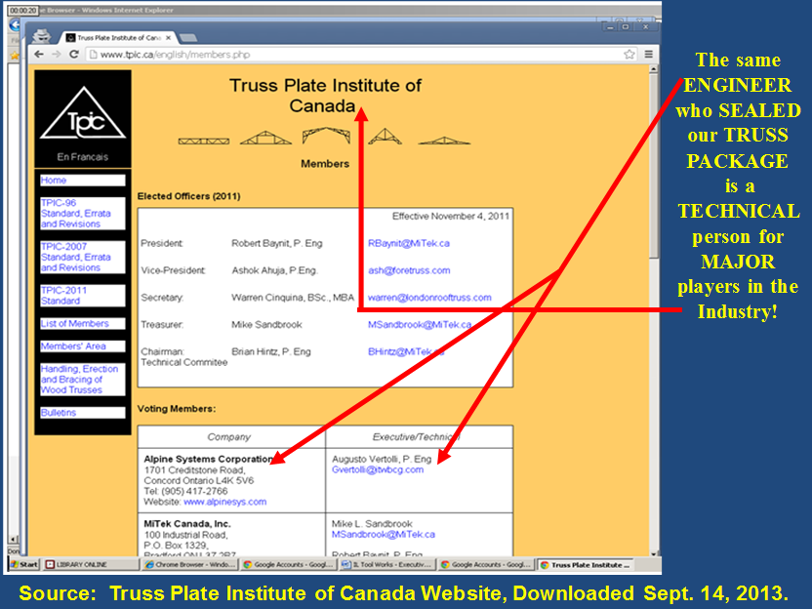
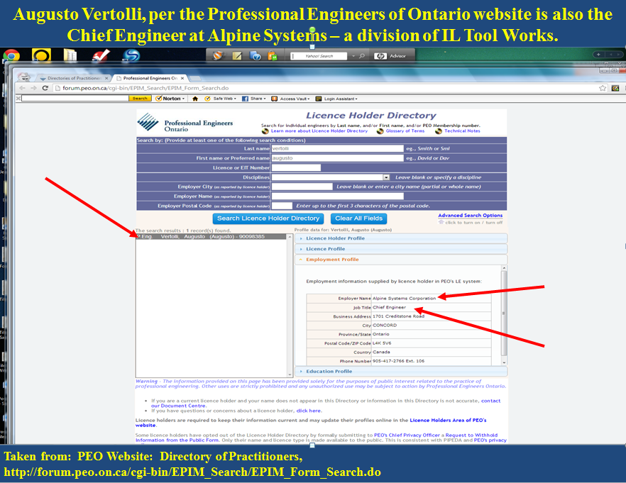
The Many Hats of Augusto Vertolli… The truss design engineer who sealed our truss drawings and had given us the wrong truss in load bearing wall next to a cathedral ceiling… A man who had “all claims of negligence against him dismissed” 3 DAYS AFTER THE TRIAL WAS OVER… AND without a single argument heard by the court!!!

Slide 20
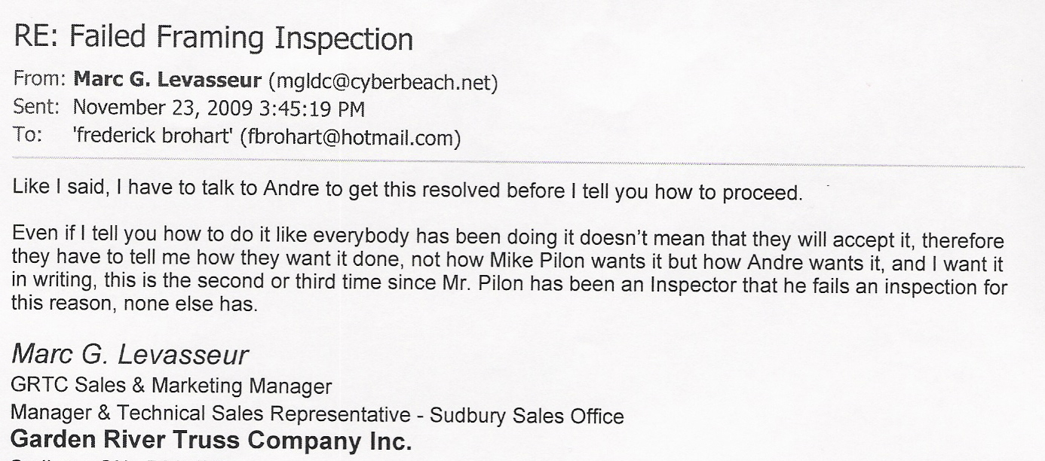
HISTORY of a problem… and “different fixes” recommended by
a NON-engineer… in matters of structural integrity…
and it gets… much, much worse… for all municipalities… for banks… for insurers… for homeowners… for taxpayers… for investors… for enforcement agencies…
for the Province… … and more!
Source: Email from BCIN Designer, Marc Levasseur to F. Brohart, Nov. 23, 2009.

Slide 21
HISTORY OF A PROBLEM…
AT THE PROFESSIONAL ENGINEERS OF ONTARIO (PEO), THE ONTARIO BUILDING OFFICIALS ASSOCIATION, TARION, THE MMAH (per PEO letter above)
AT THE MUNICIPALITY (per emails above)
AND AT ALPINE SYSTEMS (per letter below)…

Slide 22
HISTORY OF A PROBLEM…
AND AT ALPINE SYSTEMS…

Slide 23
PROPOSED FIXES BY THE MUNICIPALITY CONSTITUTED
NUMEROUS VIOLATIONS OF THE LAW!!!
BOTH “proposed fixes” we were provided by the City of Greater Sudbury… IN WRITING… constituted no less than 30 violations of the law… and that did not even begin to address what was, in our opinion, the “dishonesty” , wilful concealment of the issues, misconduct, etc. to which our family had been subjected by the City of Greater Sudbury…
Note that we had not been the first to have this issue… and still… we were given “proposed fixes” that constituted NUMEROUS violations of the law… thus, in our opinion, it is quite likely that the same was done to others who had this problem… and who… unlike our family… did not think to question what they were being asked to do in matters of structural integrity.
After 3 ½ years of living a nightmare, all our family has received from “public servants” are a stack of “Not My Job Letters”, and a complete violation of our rights to due process, to enjoyment of property, and a whole lot more.
Such actions… and perhaps more accurately, inactions by persons with a duty of care owed to taxpayers, homeowners (current and future), insured parties, investors, etc., in our opinion, are criminal given the implications of all this for mortgages, insurance, online fraud (real estate sales misrepresenting the value of these homes), mortgage backed securities and matters of public trust.

Slide 24
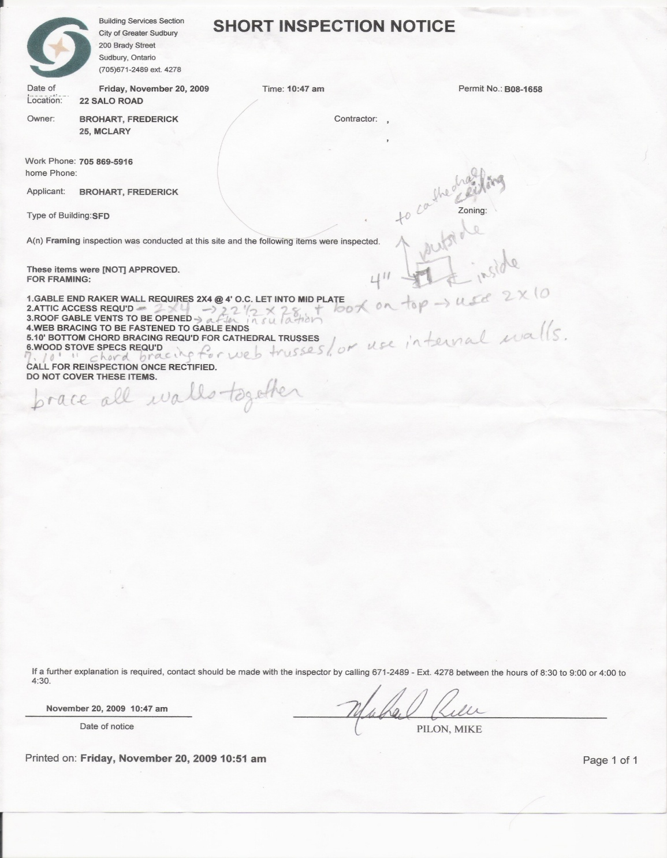
“Fix No. 1” – November 20, 2009 Inspection Notice
This “proposed fix No. 1” by City of Greater Sudbury Building Services violated the following:
OBC 1.2.2.1(1) | OBC Act 1.1(2)(a)
OBC 4.1.1.3(1) | OBC Act 1.1(2)(b)
OBC 4.1.1.4(1) | OBC Act 1.1(2)(c)
OBC 4.1.2.1(1) | OBC Act 1.1(7)(b)
OBC 4.1.3.2(1) | OBC Act 1.1(7)(c)
OBC 4.1.3.6(3) | OBC Act 1.1(6)(b)
OBC 4.1.8.15(1) | OBC Act 7.1(2)(b)
OBC 9.4.1.1(1)(a) | OBC Act 7.1(2)(c)
OBC 9.4.1.1(1)(b) | OBC Act 15.11(7)
OBC 9.23.2.1(1) | OBC Act 36(1)(a)
OBC 9.23.2.4(1) | OBC Act 36(1)(b)
OBC 9.23.5.4(1) | OBC Act 36(1)©
OBC 9.23.5.5(1) | CGS By-law 2003-26A
OBC 9.23.10.1 | Engineering Act 12(1)
OBC 9.23.10.4(1) | Engineering Act 12(2)
OBC 9.23.13.11(a) | Engineering Act 72(1)
OBC 3.2.4.7(1)(a) | Engineering Act 72(2)
OBC 3.2.4.1(3)(b) | Bill of Rights (security of person and enjoyment of property)
Note: CGS “proposed fix No. 1” did NOT fall within Part 9 of the building code (per independent engineer’s report) and thus defaulted to Part 4 (which required involvement of an engineer), and as such, this “proposed fix” violated even more sections of the OBC and/or Act and the Engineering Act of Ontario (i.e., practicing of engineering without a license)!
Note: CGS “proposed fix No. 1”, per independent engineer’s report, did not fall within Part 9 of the building code and, as such, defaulted to Part 4 and required the involvement of an engineer. As such, “this proposed fix by CGS” violated even more sections of the OBC and/or Act and the Engineering Act of Ontario!
This document is copyrighted property of J.A. Brohart

Slide 25
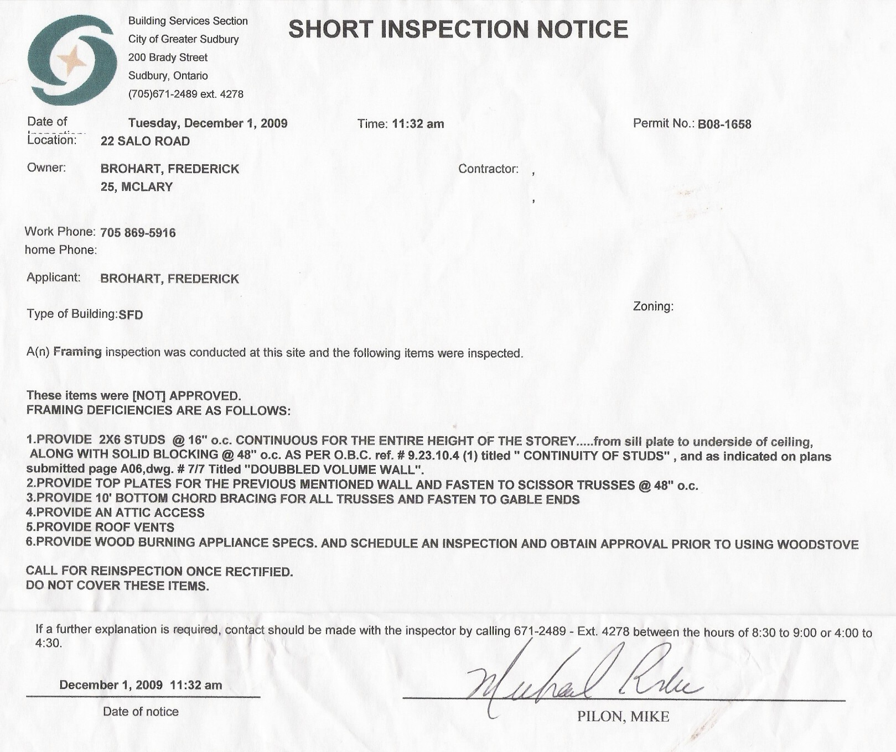
“Fix No. 2” – December 1, 2009 Inspection Notice
This “proposed fix No. 2” by City of Greater Sudbury Building Services violated the following:
OBC 1.2.2.1(1) | OBC Act 1.1(2)(a)
OBC 4.1.1.3(1) | OBC Act 1.1(2)(b)
OBC 4.1.1.4(1) | OBC Act 1.1(2)(c)
OBC 4.1.2.1(1) | OBC Act 1.1(7)(b)
OBC 4.1.3.2(1) | OBC Act 1.1(7)(c)
OBC 4.1.3.6(3) | OBC Act 1.1(6)(b)
OBC 4.1.8.15(1) | OBC Act 7.1(2)(b)
OBC 9.4.1.1(1)(a) | OBC Act 7.1(2)(c)
OBC 9.4.1.1(1)(b) | OBC Act 15.11(7)
OBC 9.23.2.1(1) | OBC Act 36(1)(a)
OBC 9.23.2.4(1) | OBC Act 36(1)(b)
OBC 9.23.5.4(1) | OBC Act 36(1)©
OBC 9.23.5.5(1) | CGS By-law 2003-26A
OBC 9.23.10.1 | Engineering Act 12(1)
OBC 9.23.10.4(1) | Engineering Act 12(2)
OBC 9.23.13.11(a) | Engineering Act - 941,72(1)
OBC 3.2.4.7(1)(a) | Engineering Act- 941,72(2)
OBC 3.2.4.1(3)(b) | Bill of Rights (security of person and enjoyment of property)
Note: CGS “proposed fix No. 2” did NOT fall within Part 9 of the building code (did not take into consideration wall height and wind loads as trusses were designed for “no wind” per truss package summary sheet) and thus any “fix” defaulted to Part 4 (which required involvement of an engineer), and as such, this “proposed fix” violated even more sections of the OBC and/or Act and the Engineering Act of Ontario (i.e., practicing of engineering without a license)!
Note: CGS “proposed fix No. 2”, did not fall within Part 9 of the building code since wall height and wind were not taken into consideration as trusses were designed for “no wind” and, as such, defaulted to Part 4 and required the involvement of an engineer. As such, “this proposed fix by CGS” violated even more sections of the OBC and/or Act and the Engineering Act of Ontario!
This document is copyrighted property of J.A. Brohart

Slide 26
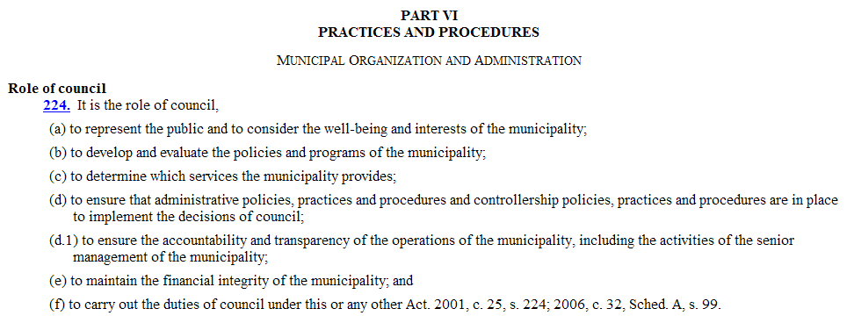
CGS Council’s DUTY TO PROTECT THE PUBLIC!!!
Source: Ontario Municipal Act 2001, S.O. 2001, CHAPTER 25, Part VI, Practices and Procedures, Municipal Organization and Administration, Role of Council, Section 224.
http://www.e-laws.gov.on.ca/html/statutes/english/elaws_statutes_01m25_e.htm

Slide 27
Note that the documentation sent to “the top echelon” constituted well over 1,000+ pages in Powerpoint along with other supporting documentation…
The documentation on this scandal is extensive…
and the paper trail spans at least 6 years back…
that we KNOW of… showing enforcement bodies, etc. KNEW of a problem YEARS ago and did, in our opinion, virtually nothing to stop it!!!
When would enforcement bodies and the police finally do their job in these matters of public safety?
Were you waiting for a collapse much bigger and deadlier than the Elliot Lake Mall collapse? The collapse of a community hall? A church? A school? What was it going to take???

Slide 28
PROOF POSITIVE…
Our family was limited to “Small Claims Court” even though this had now cost us well over 100,000.00 in extra expenses… but… given “the scope of the problem” and “the players”… no law firm would touch this one until it went public and class action… and so… our rights continued to be trampled upon as all we were given were “Not My Job” letters from a whole lot of folks with a whole lot at stake!
Was it any wonder that our designer went from “small law firm in Sudbury” to Global Law Firm in Toronto on the VERY day that I gave former Minister of Municipal Affairs and Housing and former deputy mayor of Sudbury, Rick Bartolucci, a summons to appear in court and on the VERY day that I also left a summons for a City of Greater Sudbury Building Services employee (our “non-engineer”) to appear in court!!!
Amazing… A GLOBAL LAW FIRM in small claims court…
In my opinion, the time had certainly come for a criminal investigation into matters of breach of public trust… especially given these issues had been given to the Ontario Provincial Police (OPP)… YEARS AGO… When the the OPP responded “in our opinion” this is “civil”, I had responded, “breach of public trust is criminal”. I asked that they return the memory stick I had provided them via trackable mail…
I STILL HAVE THAT ENVELOPE… UNOPENED… PROOF POSITIVE OF WHAT THE POLICE HAD BEEN GIVEN TO INVESTIGATE AS A CRIMINAL MATTER!!!

Slide 29
PROOF POSITIVE…
When I gave my files to the municipal police at the City of Greater Sudbury, the Chief of Police chose to “move on”!!!
I had provided my files to him MONTHS before my “kangaroo court trial”!!!
The City of Greater Sudbury Police was the “jurisdiction” where, according to the OPP, an investigation would have to begin if one was necessary.
I had provided the City of Greater Sudbury thousands of pages via email… and received NO RESPONSE whatsoever from Police Chief Elsner… who decided to “move on”… but… my issues had absolutely been documented with him and I had proof of that!

Slide 30
SUBMITTED WITHOUT PREJUDICE…
ALL INFORMATION IN THIS FILE AS WELL AS IN ANY AND ALL DOCUMENTS PERTAINING TO THIS MATTER WHICH ARE ASSOCIATED WITH THESE ISSUES AND/OR OUR INVESTIGATION OF THESE ISSUES ARE
SUBMITTED WITHOUT PREJUDICE

Slide 31
ALL INFORMATION
SUBMITTED WITHOUT PREJUDICE
“Not My Job…”
NOT EVEN FOR THE RCMP, THE ONTARIO PROVINCIAL POLICE OR MUNICIPAL POLICE…
IN MATTERS OF BREACH OF PUBLIC TRUST
BY ELECTED OFFICIALS AND ENFORCEMENT BODIES…
“Not My Job…”
A phrase that – in matters of public safety - was unacceptable!
Copyrighted by Jeanne A. Robitaille-Brohart

